Slide 1




Mood Mirror : Analysing Sentiments

Slide 2
INTRODUCTION
Mood Mirror is a sentiment analysis project aimed at understanding and predicting the emotions conveyed in text data. In the age of digital communication, where vast amounts of text are generated daily on social media, customer reviews, and various online platforms, analyzing sentiments has become crucial. The project leverages machine learning techniques to classify sentiments as positive or negative, providing valuable insights into public opinion, customer satisfaction, and broader social trends
The aim of the Mood Mirror project is to build an efficient and accurate model that can predict the sentiment of a given text. By analyzing various features within the text, the model will classify the sentiment, enabling businesses, researchers, and individuals to better understand and respond to the emotional tone of the content. This project seeks to contribute to the growing field of sentiment analysis by offering a tool that can be used across various domains, from marketing to social sciences.

Slide 3
PROCESS
COLLECT THE DATA
IMPORTING
LIBRARIES
EDA ON DATASET
ENCODING
PANDAS
LOGISTIC REGRESSION
NUMPY
K NEAREST NEIGHBOUR
MATPLOTLIB
NAÏVE BAYES
TRAIN – TEST SPLIT
SEABORN
TENSORFLOW
SUPPORT VECTOR CLASSIFIER
SKLEARN
DECISION TREE CLASSIFIER
RANDOM FOREST CLASSIFIER
ARTIFICIAL NEURAL NETWORK
APLLY DIFFERENT MODELS
PREDICTION
ACCURACY

Slide 4
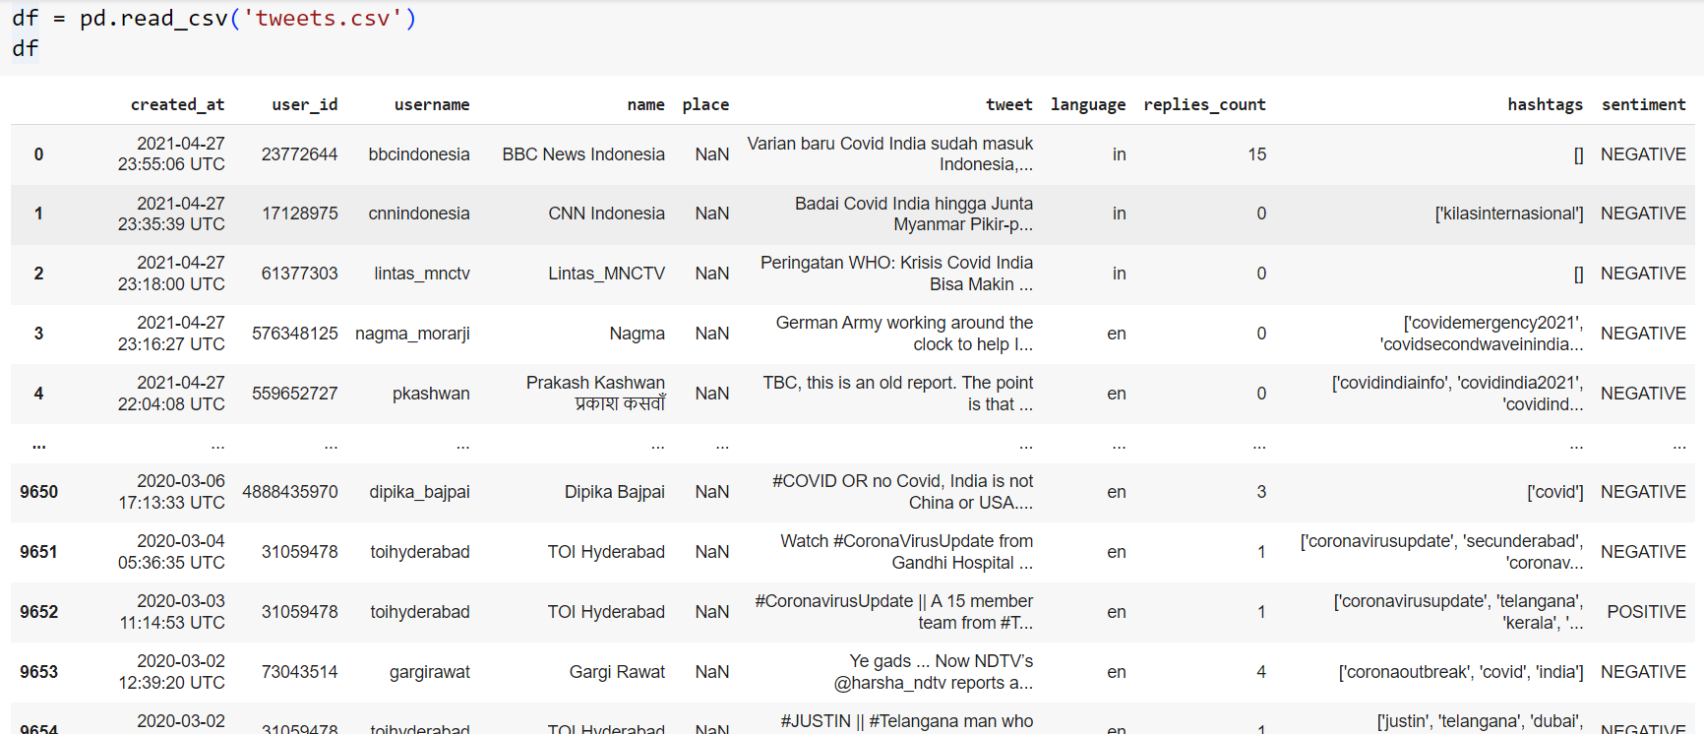
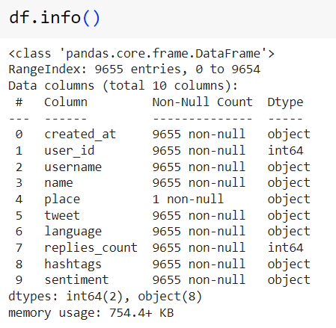
DATASET

Slide 5
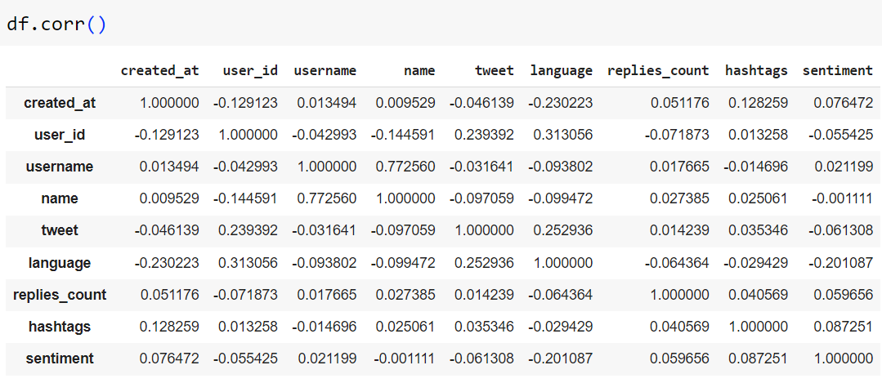
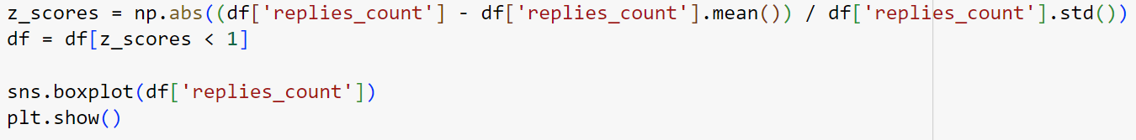
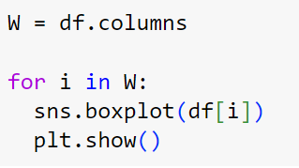
EDA – Exploratory Data Analysis
It involves analyzing and visualizing data to understand its key characteristics, uncover patterns, and identify relationships between variables refers to the method of studying and exploring record sets to apprehend their predominant traits, discover patterns, locate outliers, and identify relationships between variables.
Dropped the column which contains null values
Finding correlation between the columns
Treating Outliers
https://www.geeksforgeeks.org/what-is-exploratory-data-analysis/
Finding Outliers

Slide 6
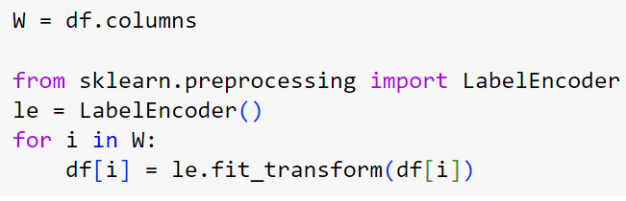
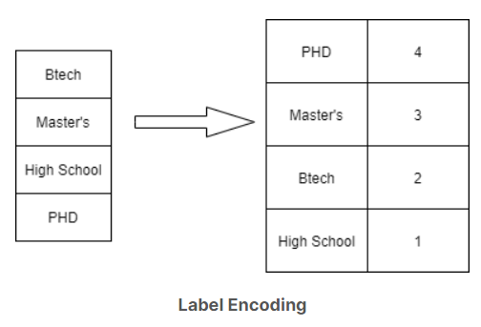
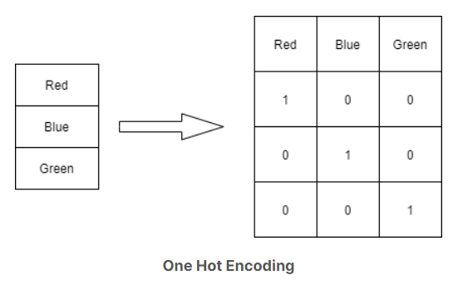
ENCODING
Encoding is a technique of converting categorical variables into numerical values so that it could be easily fitted to a machine learning model.
ENCODING
LABEL
ONE HOT
https://ai-ml-analytics.com/encoding/
https://ai-ml-analytics.com/encoding/

Slide 7
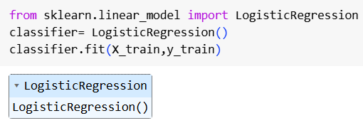
MODELS
1. LOGISTIC REGRESSION
Logistic regression is used for binary classification where Sigmoid function is used , that takes input as independent variables and produces a probability value between 0 and 1.
Y
1
Yes/ No
Threshold value
0
No/ Yes
X
https://www.geeksforgeeks.org/understanding-logistic-regression/

Slide 8
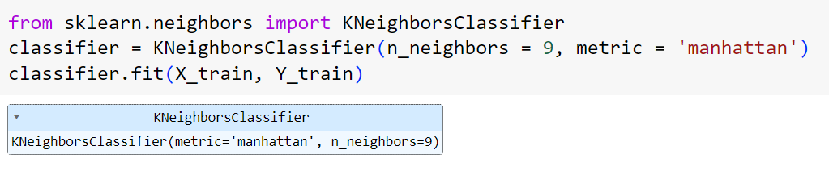
2. K NEAREST NEIGBOUR
The K-Nearest Neighbors (KNN) algorithm operates on the principle of similarity.
It predicts the label or value of a new data point by considering the labels or values of its K nearest neighbors in the training dataset.
Y
Y
Y
K = 5
X
X
X
- CLASS A
- CLASS B
- NEW DATA POINT
https://www.geeksforgeeks.org/k-nearest-neighbours/

Slide 9
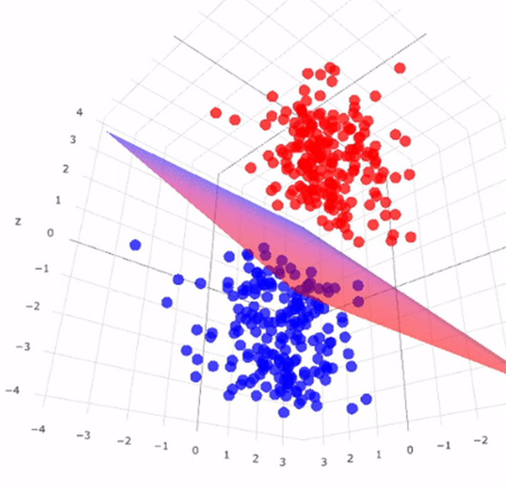
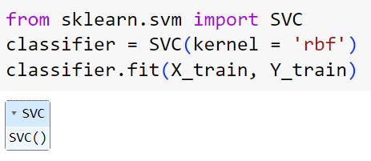
3. SUPPORT VECTOR CLASSIFIER
Y
Optimal Hyperplane
An algorithm that classifies data by finding an optimal line or hyper plane that maximizes the distance between each class in an N-dimensional space.
Support Vector
X
https://miro.medium.com/v2/resize:fit:938/1*Lsun5-t67owndP0iTV9DNQ.png
https://www.geeksforgeeks.org/support-vector-machine-algorithm/

Slide 10
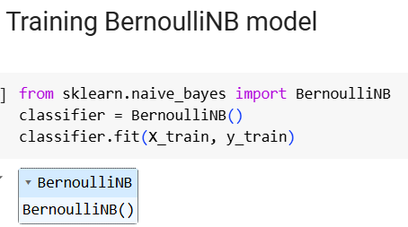
P(A∣B)=P(B)P(B∣A)P(A)​
4. NAÏVE BAYES CLASSIFIER
The “Naive” part of the name indicates the simplifying assumption made by the Naïve Bayes classifier. The classifier assumes that the features used to describe an observation are conditionally independent, given the class label. The “Bayes” part of the name refers to Reverend Thomas Bayes, an 18th-century statistician and theologian who formulated Bayes’ theorem.
Posterior
Priori
Likelihood
P(A∣B)=P(A)P(B∣A)
​ P(B)
Marginal
https://www.geeksforgeeks.org/naive-bayes-classifiers/

Slide 11
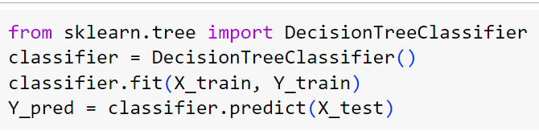
5. DECISION TREE CLASSIFIER
An algorithm where the data is continuously split according to a certain parameter. The tree can be explained by two entities, namely decision nodes and leaves. The leaves are the decisions or the final outcomes. And the decision nodes are where the data is split.
ROOT NODE
INTERMEDIATE NODE
LEAF
NODE
DECISION
https://www.geeksforgeeks.org/decision-tree/

Slide 12
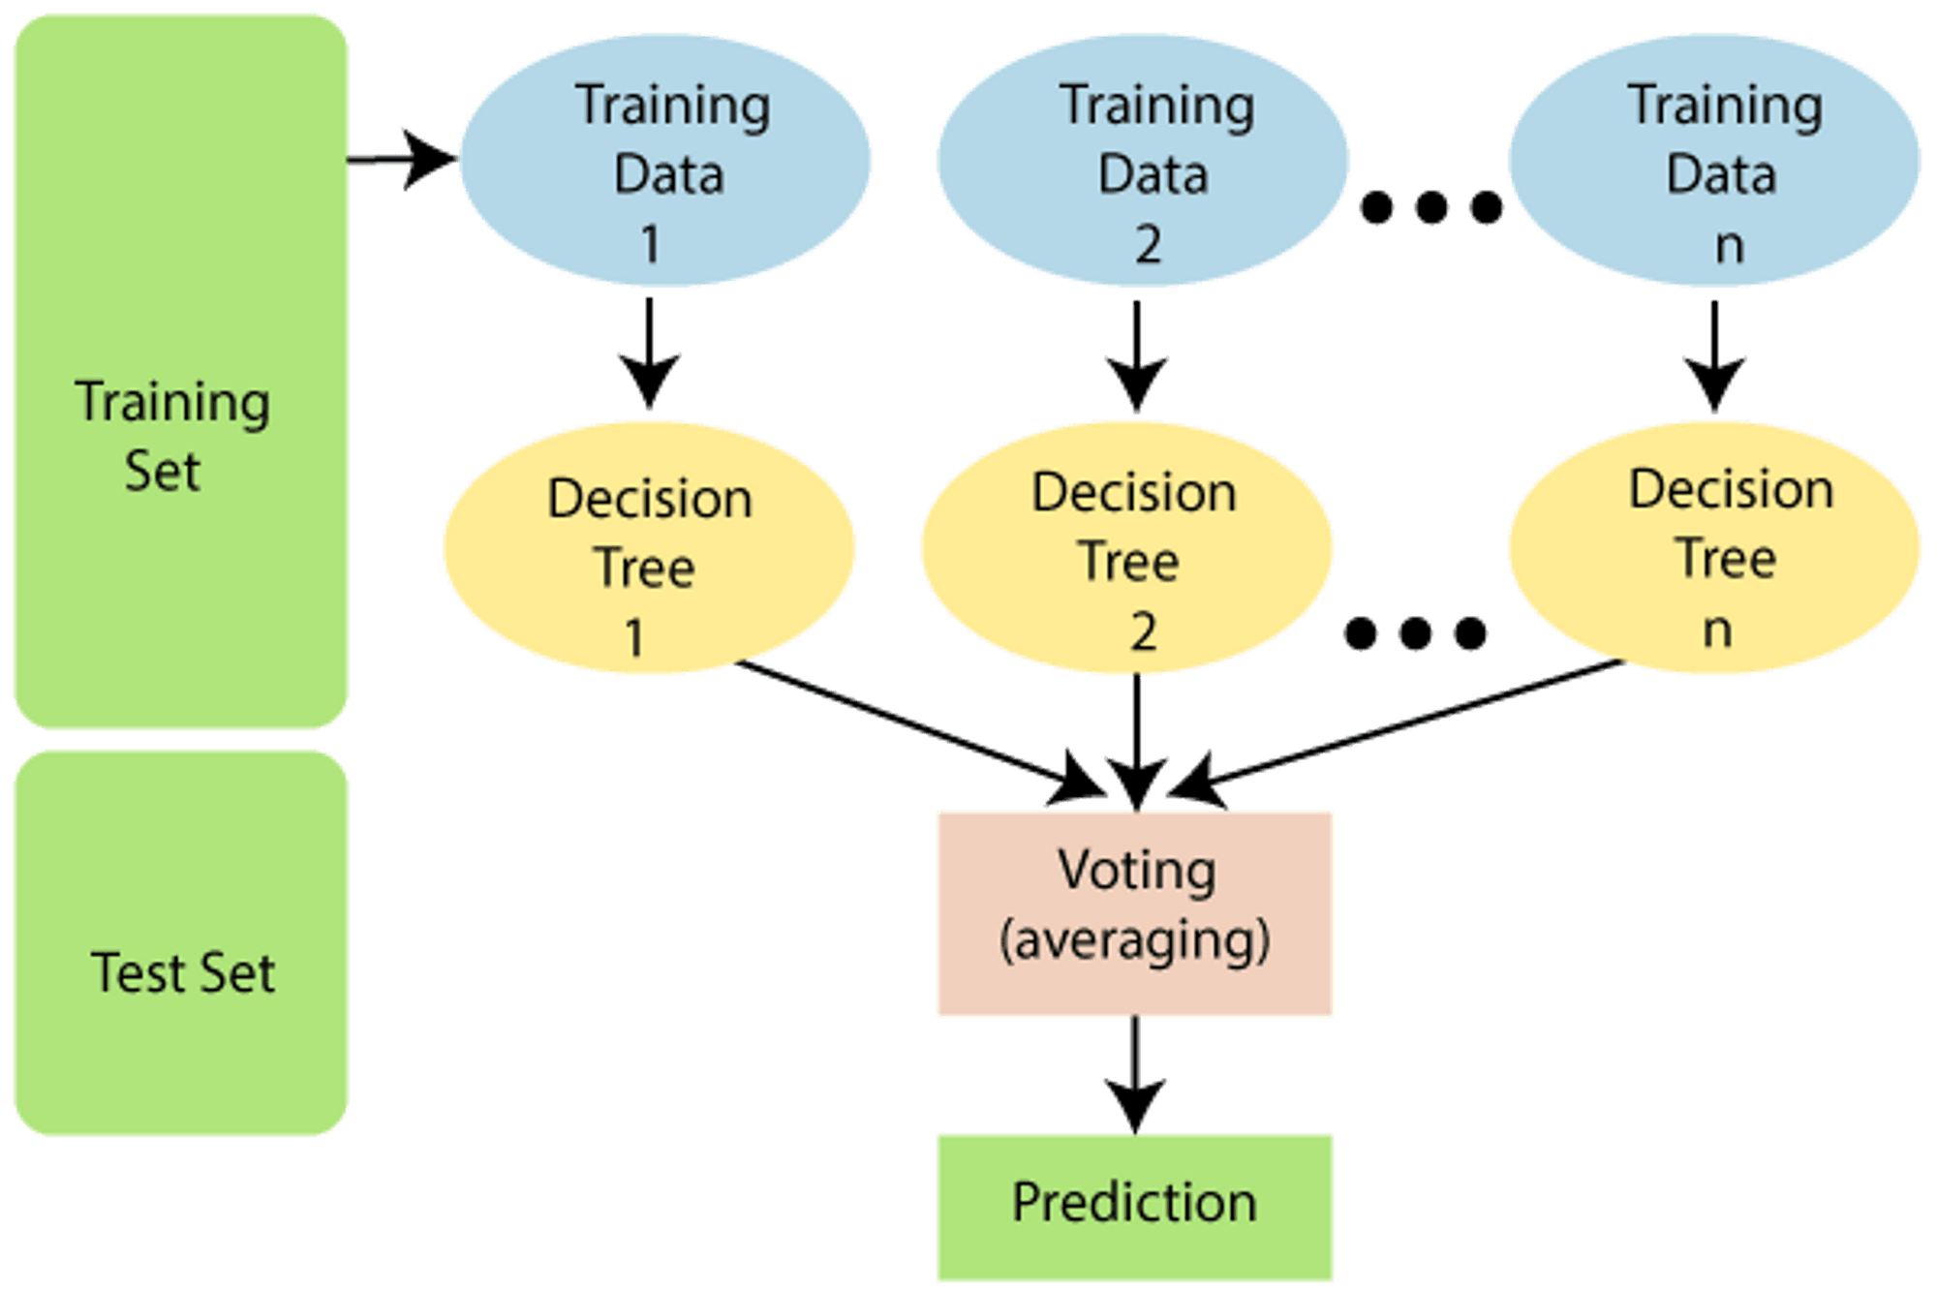
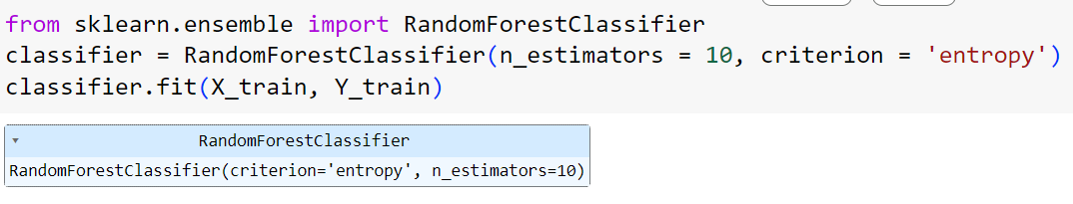
6. RANDOM FOREST CLASSIFIER
It is a set of decision trees (DT) from a randomly selected subset of the training set and then It collects the votes from different decision trees to decide the final prediction..
https://www.geeksforgeeks.org/random-forest-algorithm-in-machine-learning/

Slide 13
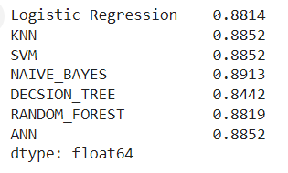
CONCLUSION
K-Nearest Neighbors (KNN), Support Vector Machine (SVM), and Artificial Neural Network (ANN) models all achieved the highest accuracy, each at 88.52%. Logistic Regression, Random Forest, and Decision Tree models performed slightly lower but still within a close range, while the Naive Bayes model had the lowest accuracy at 84.35%.

